Slide 1
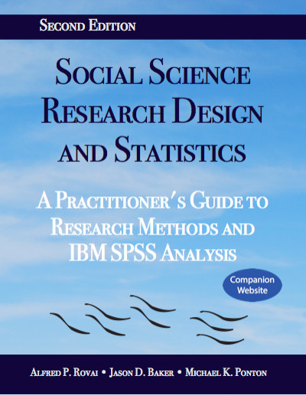
Social Science Research Design and Statistics, 2/e
Alfred P. Rovai, Jason D. Baker, and Michael K. Ponton
Pearson Product-Moment Correlation
PowerPoint Prepared by
Michael K. Ponton
IBM® SPSS® Screen Prints Courtesy of International Business Machines Corporation,
© International Business Machines Corporation.

Slide 2
Uses of the Pearson Product-Moment Correlation
Determine the strength and direction of the linear relationship between two continuous variables.
Test the hypothesis that there is no linear relationship between two variables in the population (i.e., zero correlation in the population; ρ = 0).

Slide 3
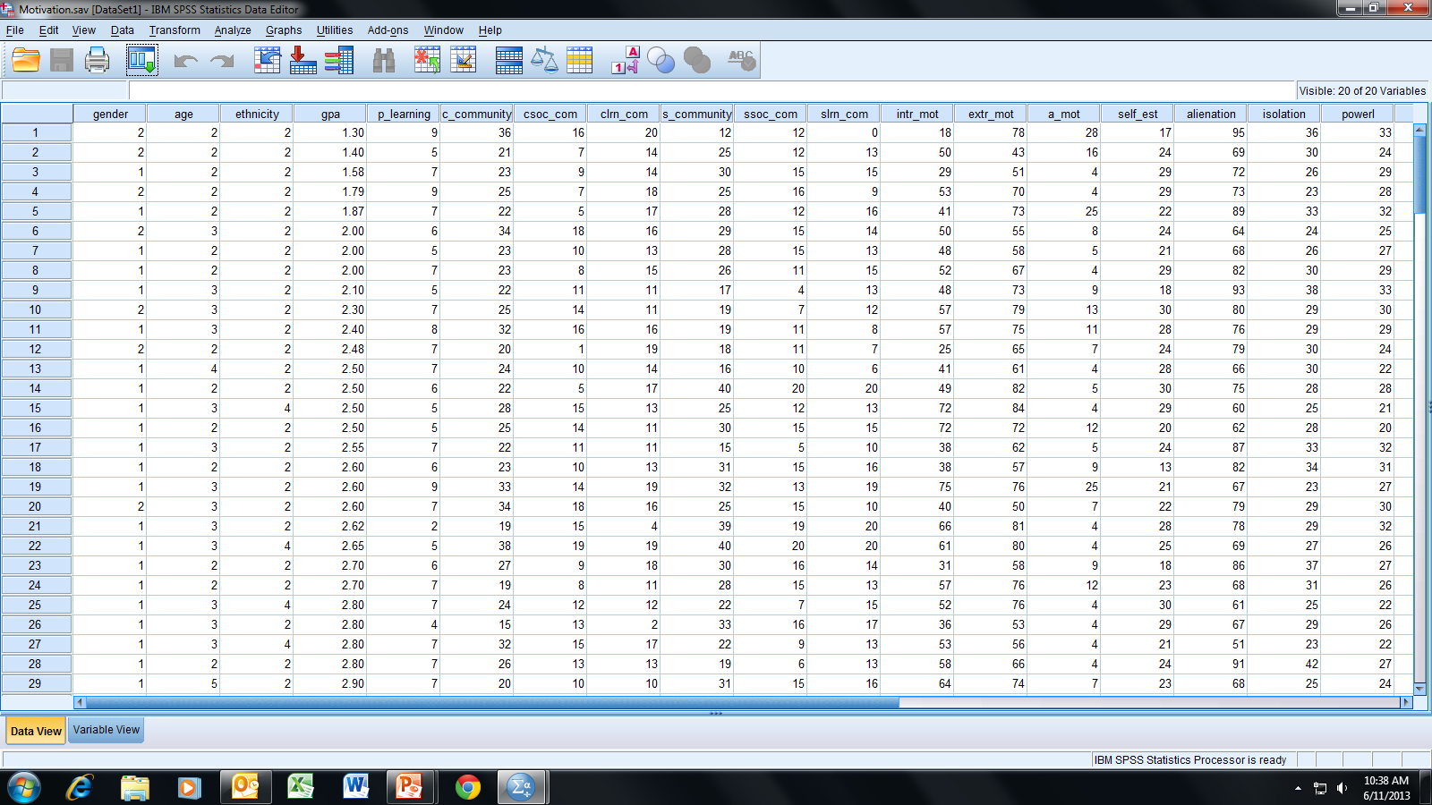
Open the dataset Motivation.sav.
File available at http://www.watertreepress.com/stats

Slide 4
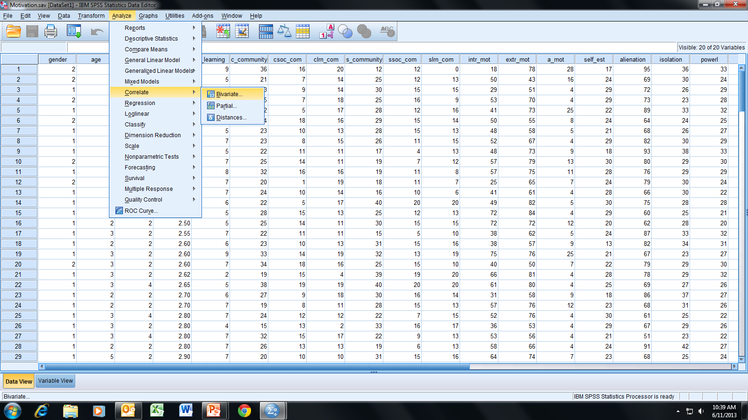
Follow the menu as indicated.

Slide 5
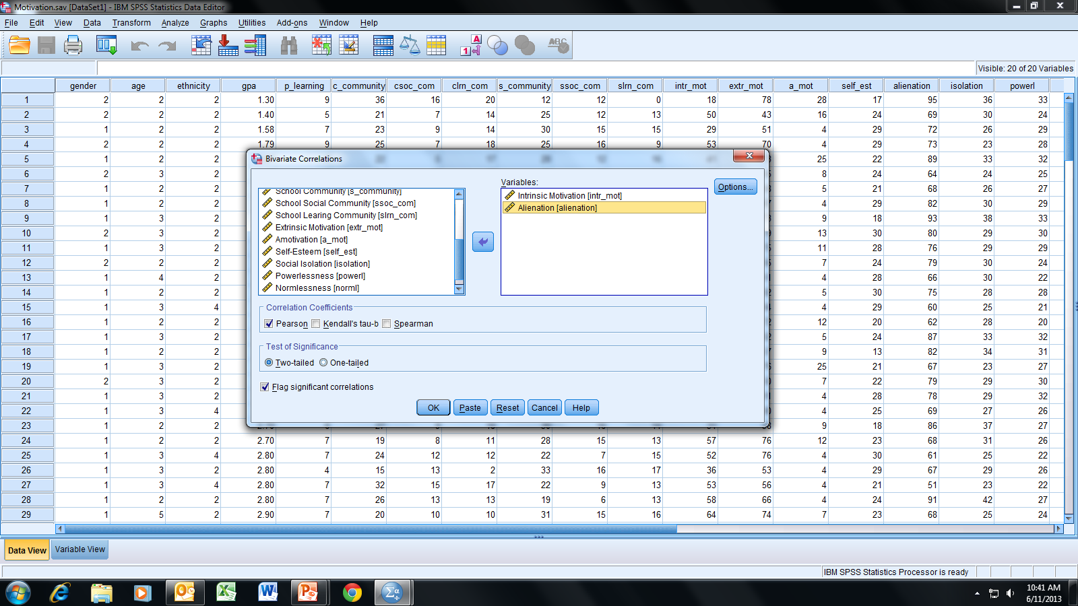
In this example, we will test the following null hypothesis:
H_{o}: There is no linear relationship (i.e., zero correlation) between
intrinsic motivation and alienation (i.e., ρ = 0).
Select and move Intrinsic Motivation [intr_mot] and
Alienation [alienation] to the Variables box; click OK.

Slide 6
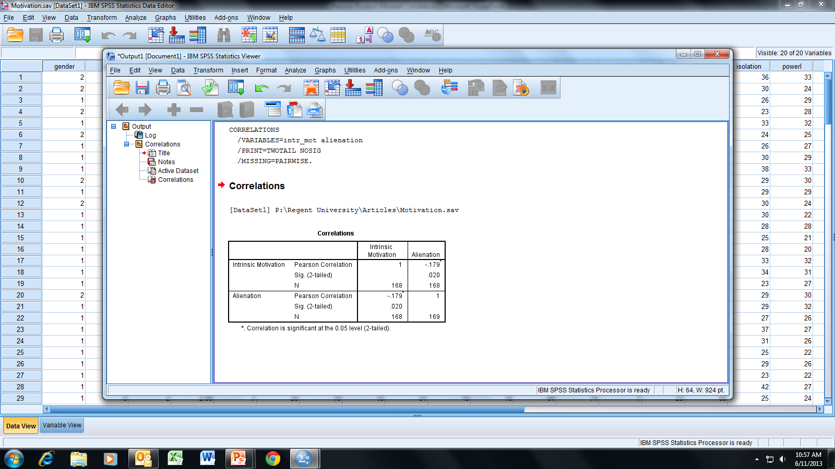
The output below is referred to as a “correlation matrix.”
It presents all bivariate (i.e., 2-variable) Pearson correlations.

Slide 7
Note that the “diagonal” contains only correlation values
of “1”; a variable correlated with itself results in a perfect
positive linear relationship.

Slide 8
The correlations in the matrix are mirror images about
the diagonal (this is referred to as a symmetric matrix).
Usually in publications, only one-half of the matrix is
presented because of this symmetry.

Slide 9
For the Pearson product-moment correlation we are testing the null hypothesis
H_{o}: ρ = 0; that is, there is no linear relationship (i.e., zero correlation) between
the variables in the population.
We will choose α = .05 for a two-tailed test (i.e., we are interested if the
correlation is either positive or negative). Note that the significance value of
.020 < α; therefore, we reject H_{o} and conclude that there is a statistically
significant relationship between intrinsic motivation and alienation.

Slide 10
Because the correlation is statistically significant, we can further interpret
the correlation as follows:
The correlation is negative; thus, as one variable increases in value, the
other variable decreases in value (i.e., inverse relationship).
The absolute value of the correlation suggests little if any correlation;
cf. Hinkle, D. E., Wiersma, W., & Jurs, S. G. (1998). Applied statistics for
the behavioral sciences (4th ed.). Boston, MA: Houghton Mifflin. p. 120.
There is 3.2% of common variance between the two variables (i.e., -.179²
= .032).

Slide 11
When r is determined to be statistically significant, you should evaluate its practical significance:
Rule of thumb for interpreting the absolute value of r.
.90 to 1.00 very high correlation
.70 to <.90 high correlation
.50 to <.70 moderate correlation
.30 to <.50 low correlation
.00 to <.30 little if any correlation
Source:
Hinkle, D. E., Wiersma, W., & Jurs, S. G. (1998). Applied statistics for the behavioral
sciences (4th ed.). Boston, MA: Houghton Mifflin.

Slide 12
End of Presentation

